Slide 1

The Healthy Table
Final Project for CSYE 6220
Shuaibo Gao
gao.shua@husky.neu.edu
NUID: 001725554

Slide 2


The Problem?
Knowing what to eat can be confusing
Have no ideas about what is or is not good for us
Not able to track calorie taken in every day
No way to order healthy food online with clear health information. Yelp? Unfortunately, it doesn’t!
Restaurant have no channel to push their healthy food

Slide 3

What is the Solution?
The Healthy Table provides you dinning recommendations
The Healthy Table tells you what is the best for you by using a health formula
The Healthy Table can track the calorie every day for you
The Healthy Table can give a clear calorie for each dishes
The Healthy Table help healthy restaurant attract customer who want healthy food

Slide 4
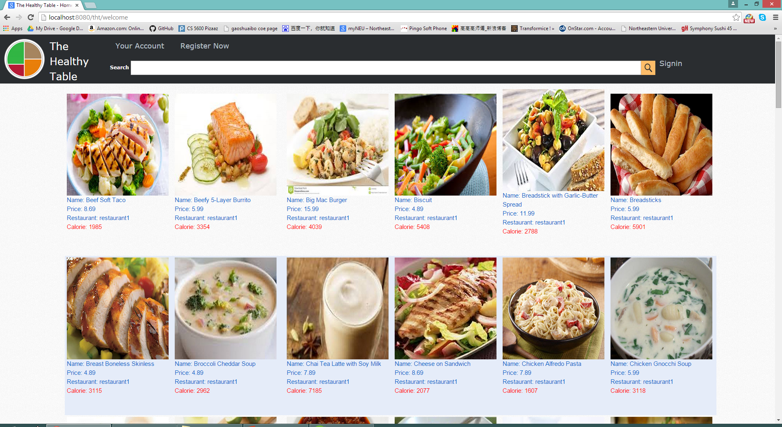
Welcome Page
Clear
Attractive
Information
Search
Javascript

Slide 5
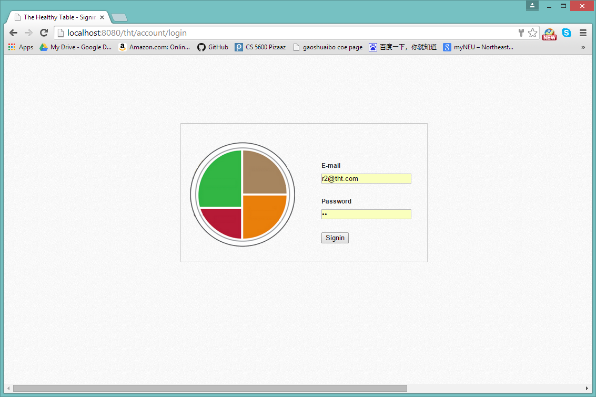
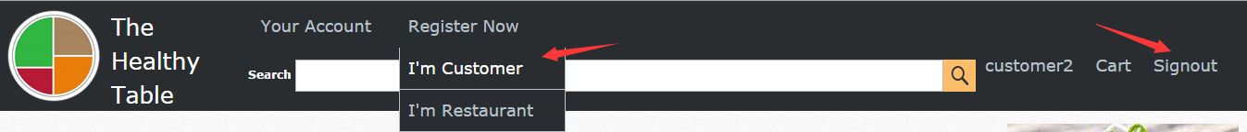
Sign Up / Sign In
Spring Security
Customized Login Window
Simple Sign in/ Sign out
Easily Register

Slide 6
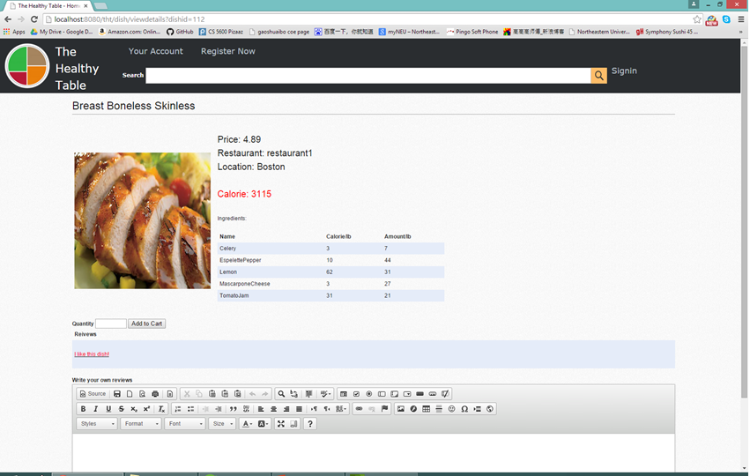
Dishes Information
Detailed
Image
Calories
Ingredient
Amount
Review
ckeditor

Slide 7
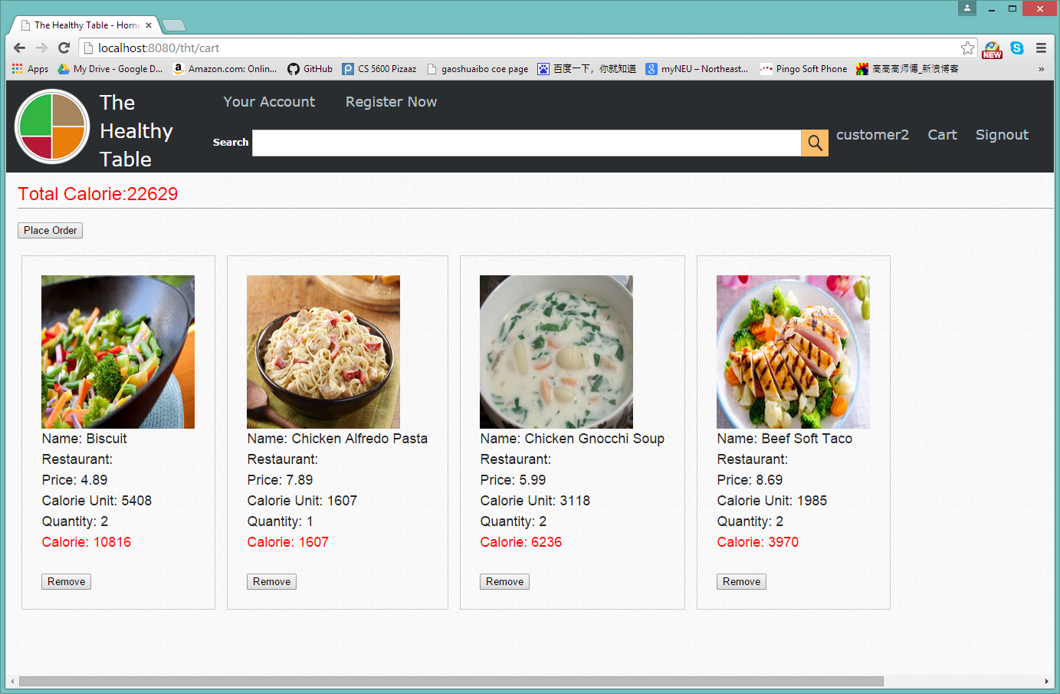
Cart
Total Calorie
Each Calorie
Calorie Unit
Remove

Slide 8
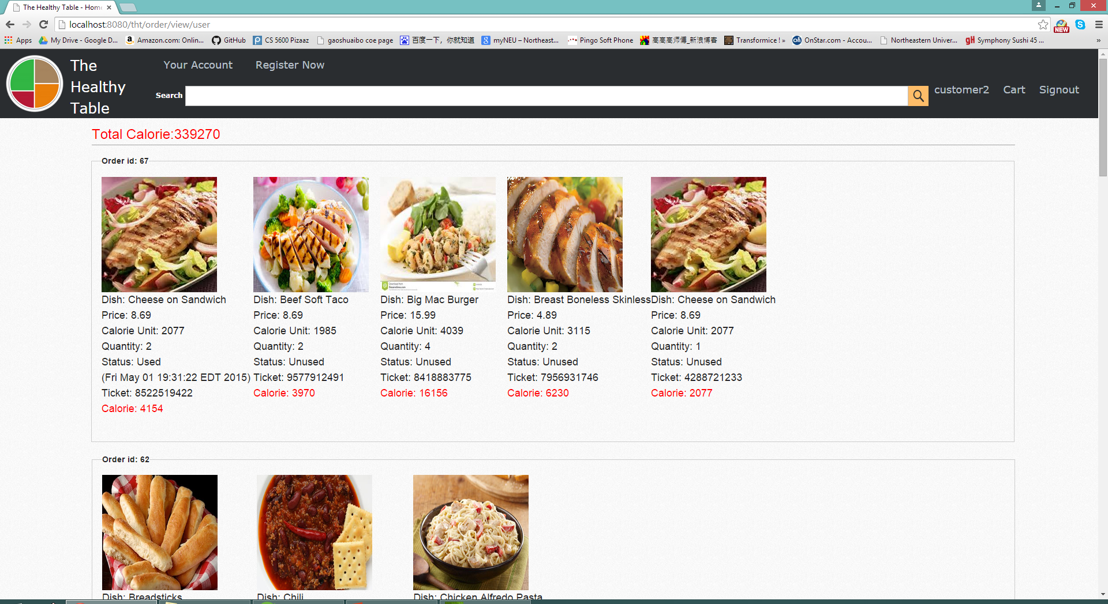
Customer Order
Total Calorie
Each Calorie
Unit Calorie
Ticket
Status
Consume Time

Slide 9
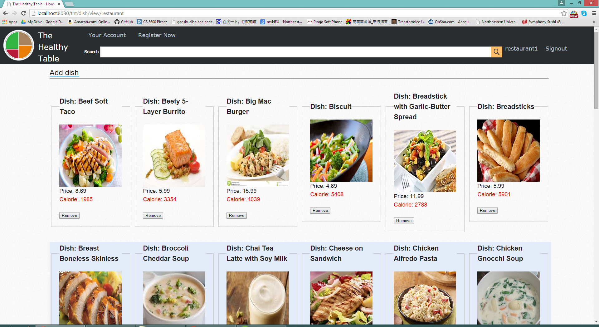
Restaurant Menu
Image
Price
Calorie
Remove
Add dish

Slide 10
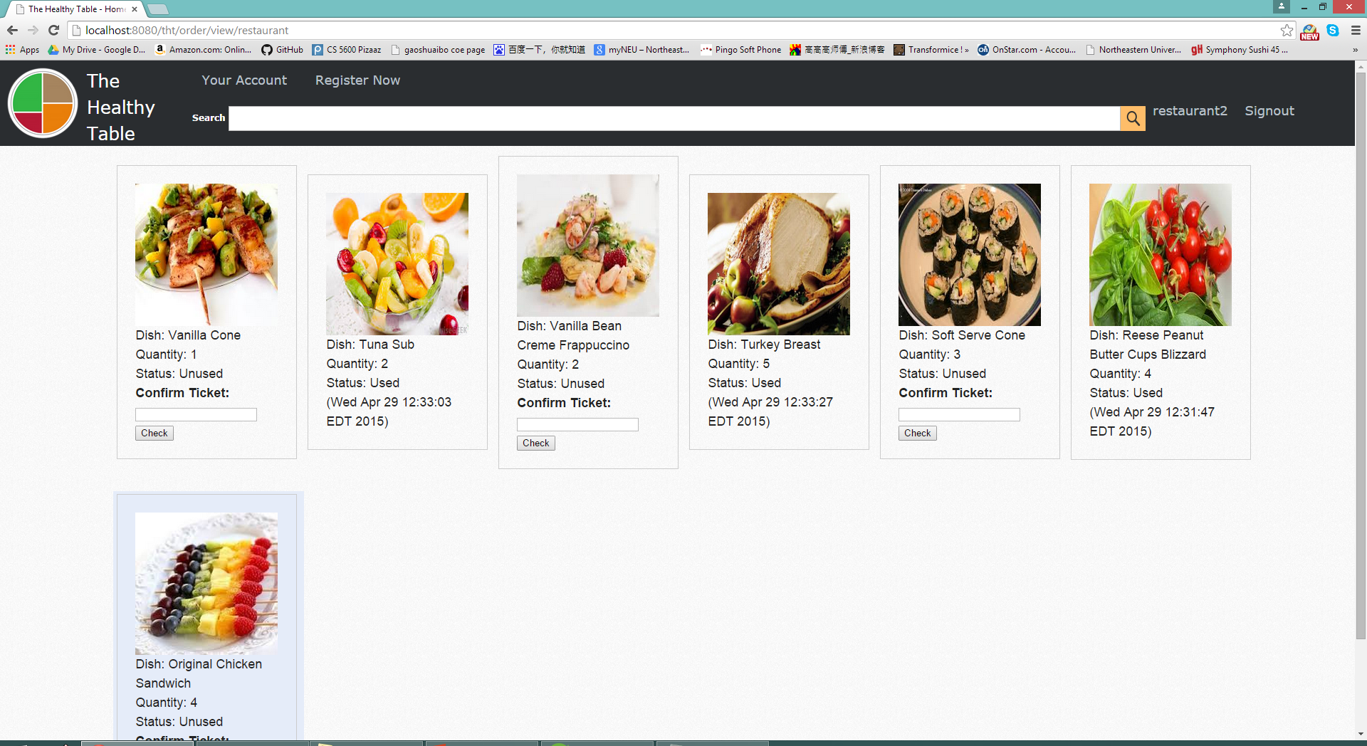
Consume at Restaurant
Ticket
Code
Order
Confirm

Slide 11
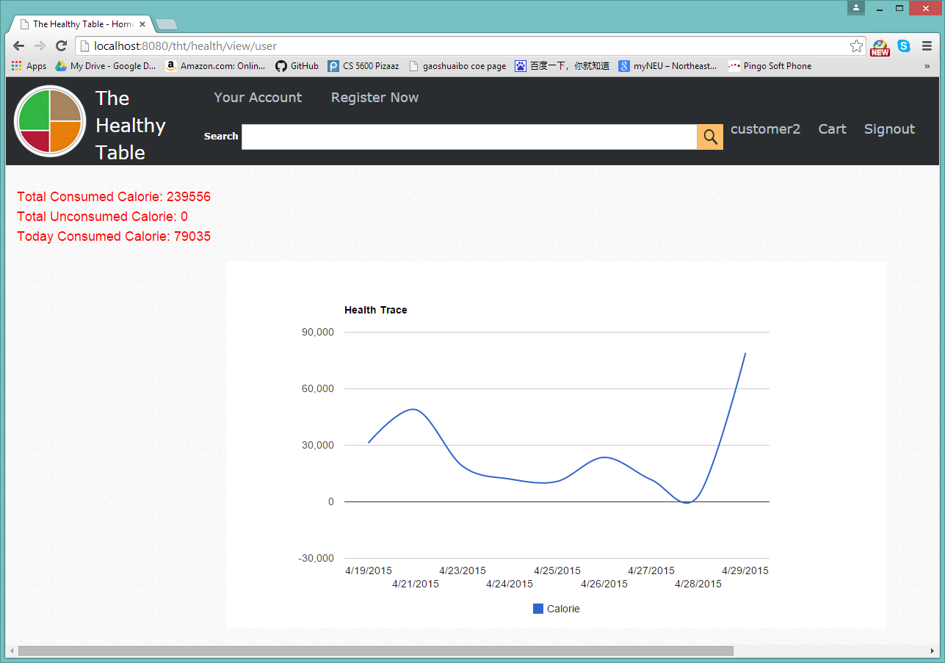
Graphic Calorie Tracker
Every Day
Accurate
Clear
Google Chart API
Javascript
JSON

Slide 12
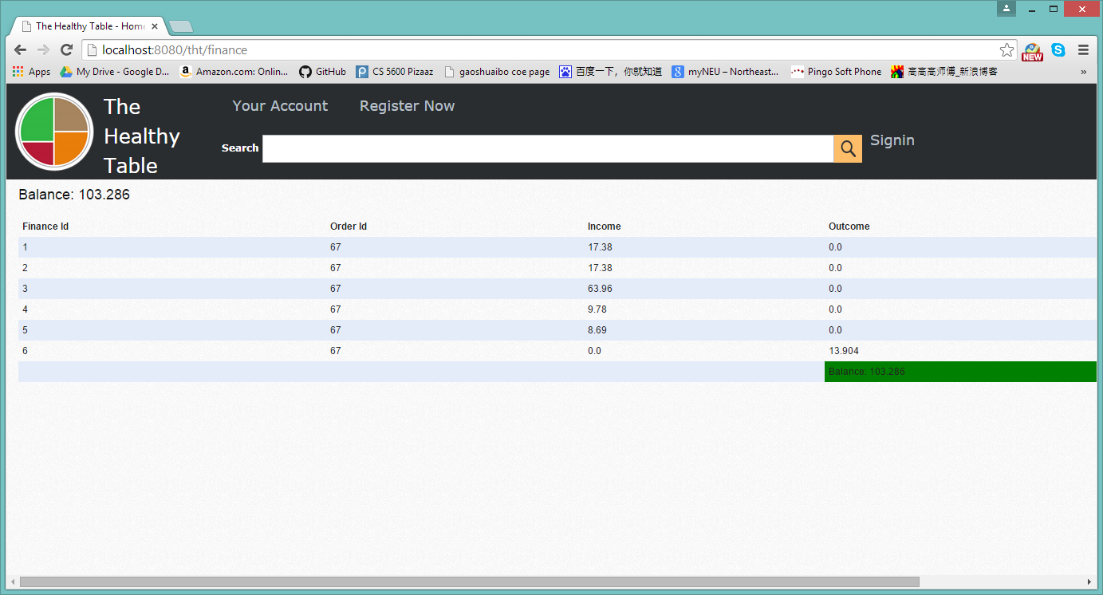
System Finance Report
Every Payment
Income
Outcome
Balance

Slide 13
Right at The Healthy Table
Final Project for CSYE 6220
Shuaibo Gao
gao.shua@husky.neu.edu
NUID: 001725554

